Slide 2
Azure's Integration Platform
Building Serverless Applications

Slide 3



Eldert Grootenboer
@egrootenboer
Notes:
Technology Lead Azure & Integration

Slide 4
Azure Integration Services

Slide 5

Integration scenarios
Application to Application
Business to Business
SaaS
IoT
Notes:
The architecture of applications

Slide 6
Integration challenges
Interfaces and APIs
Data sources and formats
Service-oriented and distributed
On-premises or cloud
Notes:
Despite the number of applications, there in an intrinsic dependencies to integration systems and applications, as they have multiple ways to address security, interfaces, data sources, they are distributed, run on premises or in the cloud, and each application has a unique lifecycle of updates, enhancements, fixes, etc.
It is costly to maintain integration code with multiple interfaces, APIs, data sources and formats, when applications are distributed across environments running on premises or in the cloud.

Slide 7
Integration Platform as a Service
Embrace the
API Economy
Establish a
Flexible Platform
Connect
SaaS, On-Prem, & Cloud
Notes:
Source: Gartner - Magic Quadrant for Enterprise Integration Platform as a Service, published April 2018

Slide 8



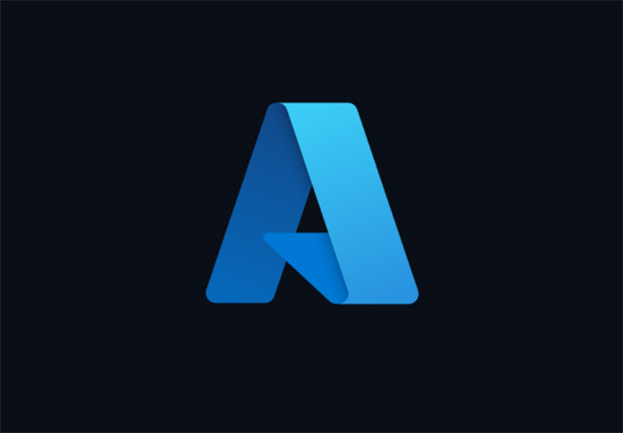




Azure Integration Services
Microservice and API orchestration with Logic Apps
Serverless compute execution with Functions
Create, access control, usage analysis, and management of APIs thanks to API Management
Extract, Load, Transform data with Data Factory
Enterprise messaging with Service Bus
Event Grid for raising and delivering events

Slide 9



API Management
Connected experiences
Publish
Mediate
Consume
APIs
API Publishers
(provide APIs)
Azure portal
Gateway
Developer portal
App Developers
(use APIs)
Services and data
Notes:
Talk about the challenge, and how API Management solves each of these.
Azure Portal
Publish and maintain APIs
Set up policies, security, and access control
This is where we maintain our API catalog
Gateway
Proxy between frontend and backend
Decouples the backend from the connected experiences
Allows to implement governance and security controls without touching the backend
Developer Portal
Allows app developers to check which APIs are available
Can request access
Allows for easy getting started with testing, sample requests, and code samples
Rustig spreken!
3 minute

Slide 10
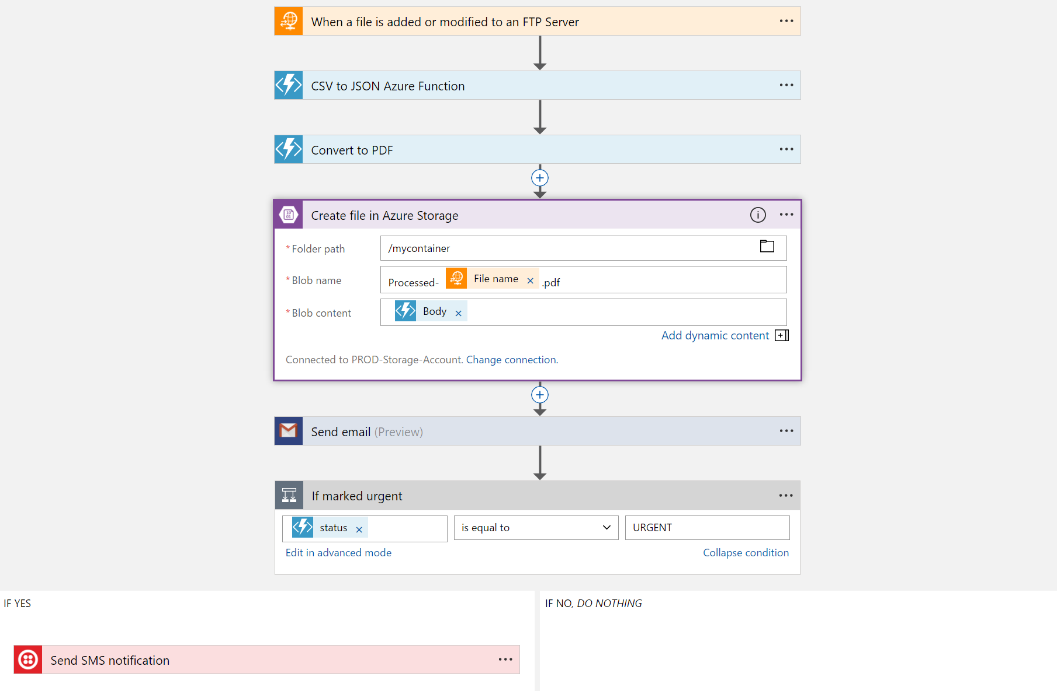
Logic Apps
Visual Designer
Workflow, triggers and actions
Applications, data and services
Notes:
Faster integration using innovative Visual Designer
Easy workflow creation with triggers and actions
Mashup applications, data and services
Built for mission critical Enterprise Integration
Create, deploy, manage and monitor

Slide 11
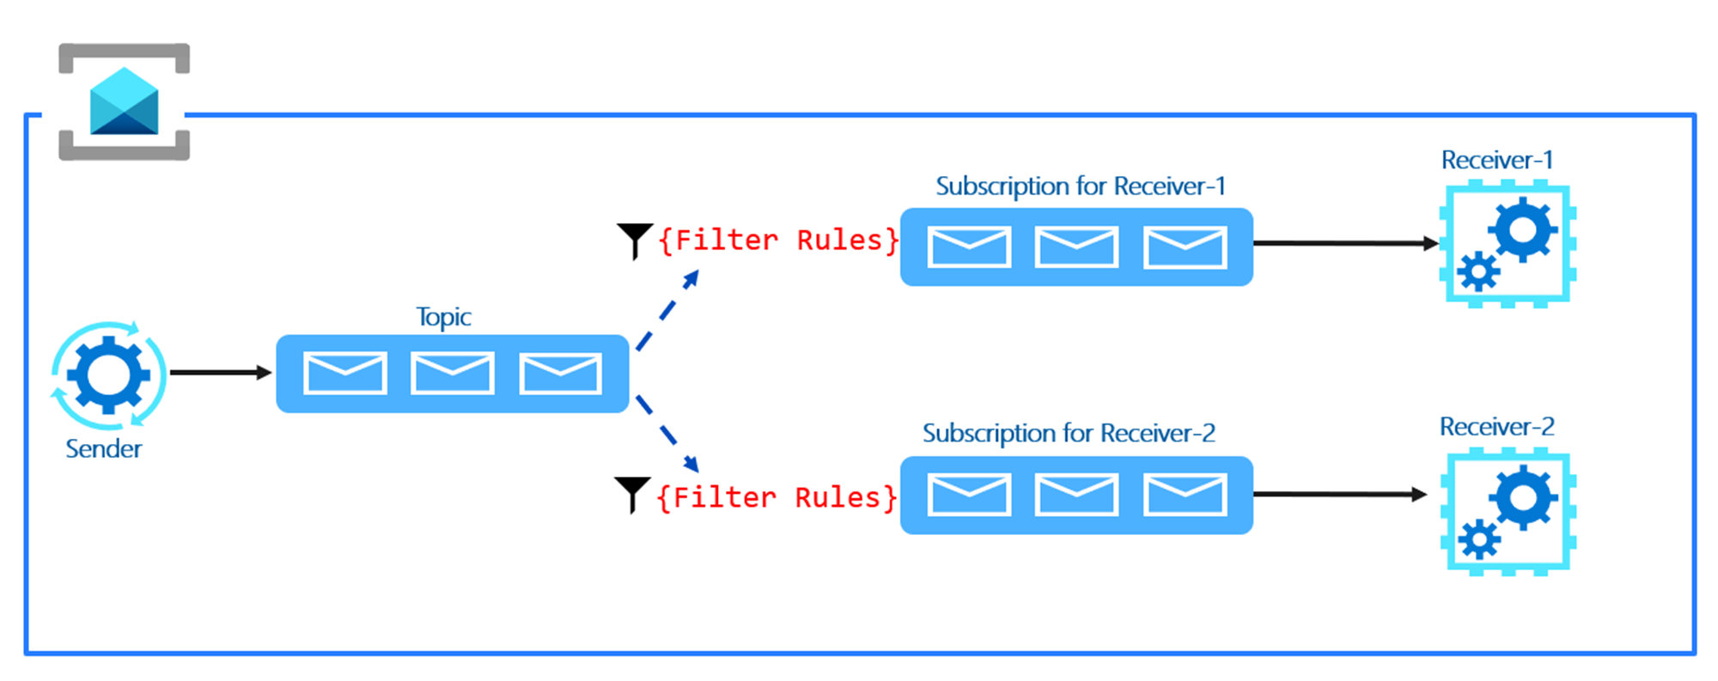
Service Bus
Queues & Topics
Reliable asynchronous communication
Message headers
Routing and filtering
Rich features

Slide 12
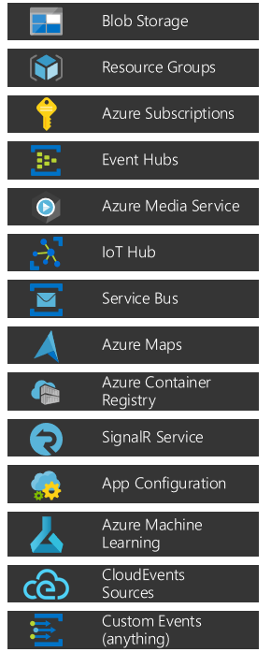
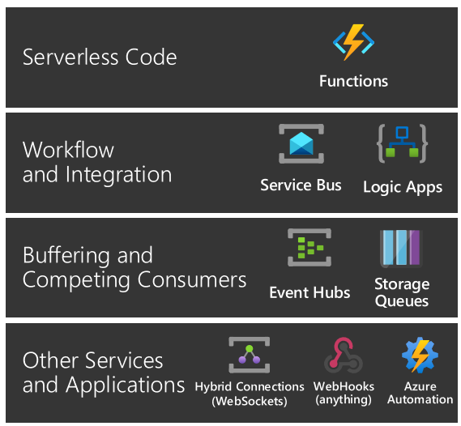


Event Grid
Events: what happened
Event Publishers: where it took place
Topics: where publishers send events
Event Subscriptions: how you receive events
Event Handlers: the app or service reacting to the event

Slide 13








Better Together
Limitless Possibilities

Slide 14








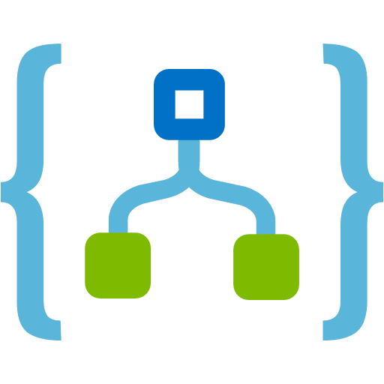



Demo – Onboarding Process

Slide 15
APIs

Slide 16
Solving our API strategy challenges
Connected experiences
Publish
APIs
Azure portal
Services and data
Notes:
Talk about the challenge, and how API Management solves each of these.
Azure Portal
Publish and maintain APIs
Set up policies, security, and access control
This is where we maintain our API catalog
Gateway
Proxy between frontend and backend
Decouples the backend from the connected experiences
Allows to implement governance and security controls without touching the backend
Developer Portal
Allows app developers to check which APIs are available
Can request access
Allows for easy getting started with testing, sample requests, and code samples
Rustig spreken!
3 minute

Slide 17
API Management
Connected experiences
Publish
Mediate
Consume
APIs
API Publishers
(provide APIs)
Azure portal
Gateway
Developer portal
App Developers
(use APIs)
Services and data
Notes:
Talk about the challenge, and how API Management solves each of these.
Azure Portal
Publish and maintain APIs
Set up policies, security, and access control
This is where we maintain our API catalog
Gateway
Proxy between frontend and backend
Decouples the backend from the connected experiences
Allows to implement governance and security controls without touching the backend
Developer Portal
Allows app developers to check which APIs are available
Can request access
Allows for easy getting started with testing, sample requests, and code samples
Rustig spreken!
3 minute

Slide 18
Smarter services with policies
Security
Caching
Throttling
Transformations
Mocking
And many more…
Notes:
8

Slide 19
Workflows

Slide 20
Logic Apps
Visual Designer
Workflow, triggers and actions
Applications, data and services
Enterprise Integration
Notes:
Faster integration using innovative Visual Designer
Easy workflow creation with triggers and actions
Mashup applications, data and services
Built for mission critical Enterprise Integration
Create, deploy, manage and monitor

Slide 21

Connected
Cloud APIs and platform functionality
Over 250 OOTB connectors
Hosted and managed
Scalable
Rapid development
Open source
API connections
Authenticate once and reuse
Simple to deploy
Easily manageable

Slide 22

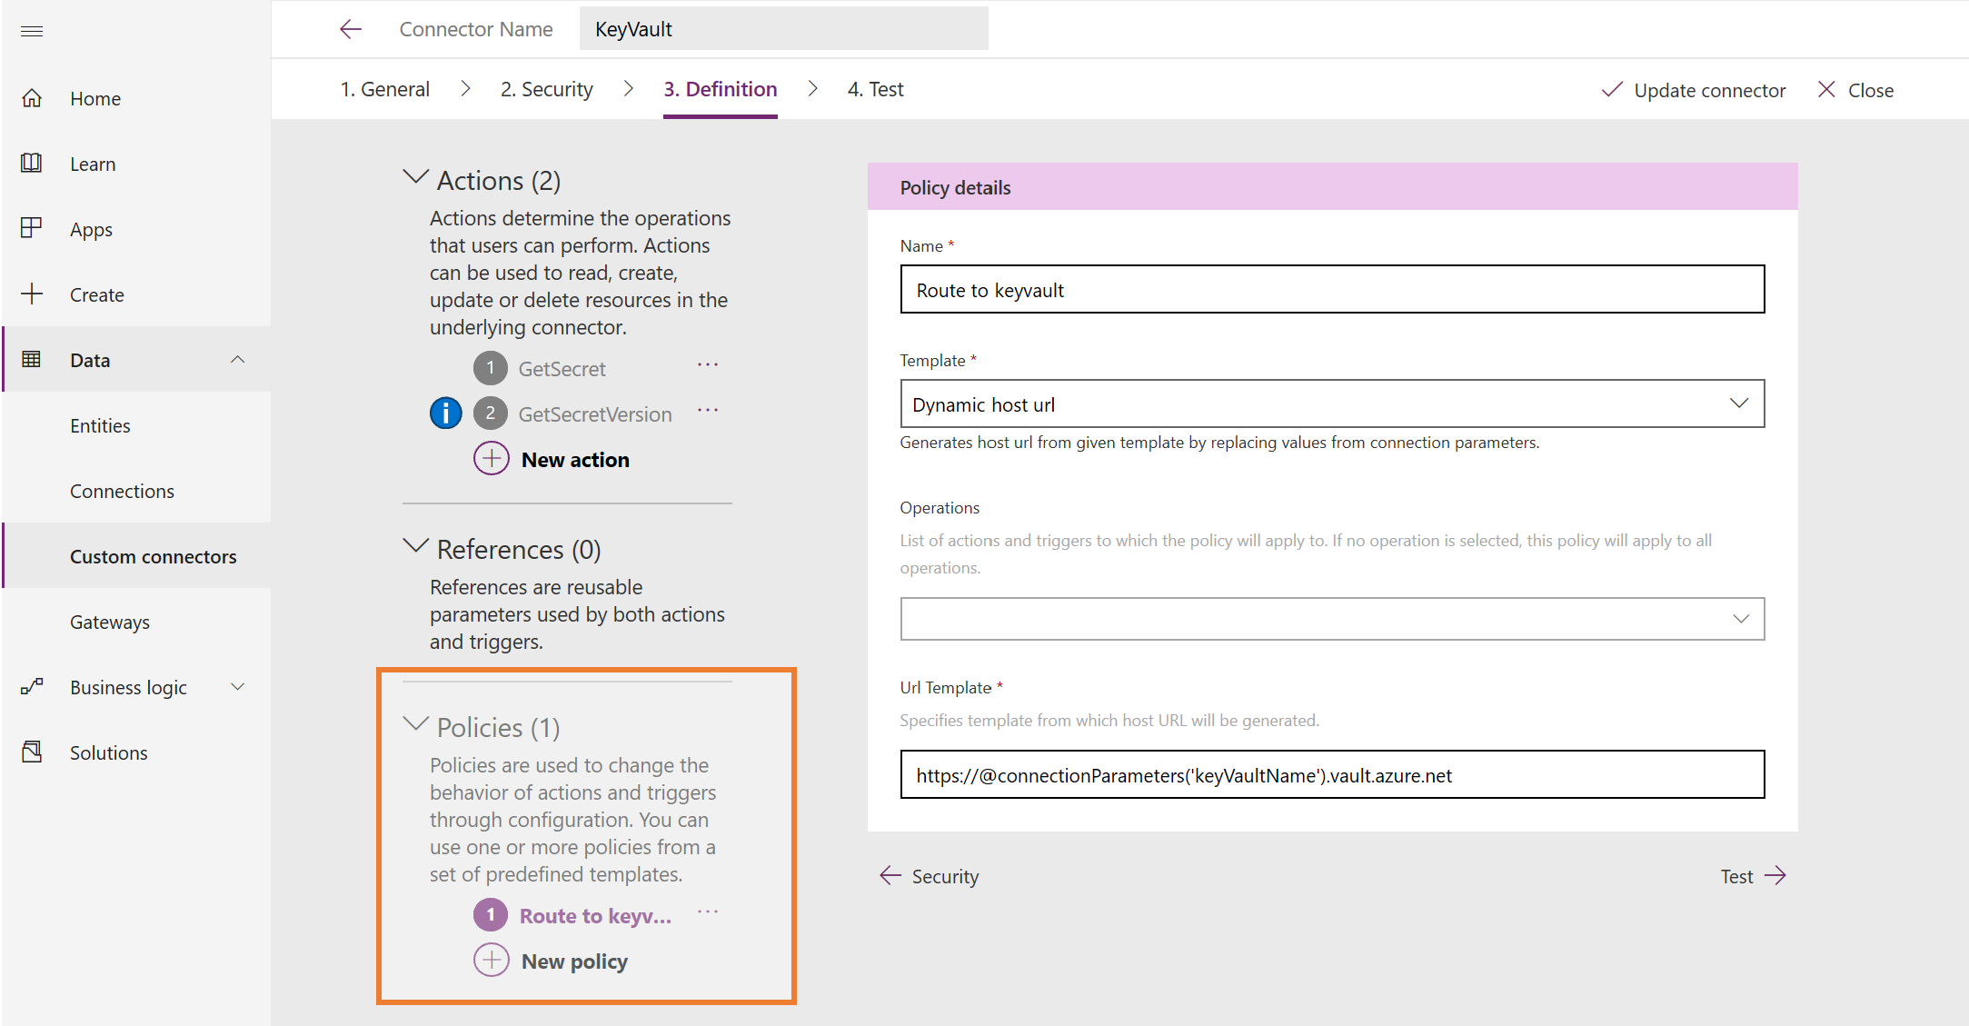
Custom Connectors

Slide 23
Messages

Slide 24
Enterprise Messaging as a Service
Queues & Topics
Reliable asynchronous communication
Message headers
Routing and filtering
Rich features

Slide 25
Features of Service Bus
Scheduled delivery
Time To Live
ForwardTo
Defer
Sessions
Batching
Auto-delete queue on idle
OnMessage
Duplicate detection
Actions
Transactions
Poison message handling

Slide 26
Topics & Subscriptions
Sender only knows about Topic
Receivers only know about Subscriptions
Filters and Actions exist on Subscriptions
type=order
Filter
Subscription 1
“type” = “order”
type=quote
Topic
“type” = “quote”
Subscription 2
Filter

Slide 27
Events

Slide 28
What is an event?
Something happened
Triggers a reaction
Based on facts
Can be series based or discrete

Slide 29
Azure Event Grid
Events: what happened
Event Publishers: where it took place
Topics: where publishers send events
Event Subscriptions: how you receive events
Event Handlers: the app or service reacting to the event

Slide 30

Advanced Filters
Works on the data portion of the event
Supports ten levels of nesting
Supports one or more values
Up to 10 advanced filters can be combined in OR
Numbers
NumberLessThan
NumberLessThanOrEquals
NumberGreaterThan
NumberGreaterThanOrEquals
NumberIn – the value for data.key equals a value in the set [0, 2.08, 3.14]
NumberNotIn – the value for data.key is not in the set [1, 11, 112, 1124]
Strings
StringContains – the value for data.key contains “the”
StringIn – the value for data.key equals a value in the set [“small”, “brown”, “fox”]
StringNotIn – the value for data.key equals a value in the set [“jumped”, “over”, “the”]
StringBeginsWith – the value for data.key begins with “lazy”
StringEndsWith – the value for data.key ends with “dog”
Boolean
BoolEquals

Slide 31
Bringing it all Together

Slide 32
Better Together
Limitless Possibilities

Slide 33
Demo – Onboarding Process

Slide 34
Almost done…

Slide 35

Key Takeaways
Serverless
Focus on value
Cost Efficient
Only pay for what you use
Better Together
Combine services to create powerful scenarios

Slide 36



Thank You!
@egrootenboer
eldert@eldert.net
https://www.linkedin.com/in/eldert-grootenboer
Notes:
Rustig spreken!

